Slide 1
State Ethics Commission
Conflict of Interest Law Seminar
Presenter: David Giannotti, Chief
Public Education and Communications Division
State Ethics Commission
617-371-9505
David.Giannotti@mass.gov

Slide 2
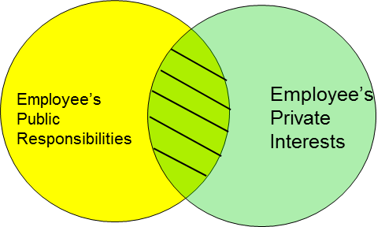
State Ethics Commission Conflicts 101
Professional Life vs. Personal Life
Focus of the Conflict of Interest Law

Slide 3
State Ethics Commission
State Ethics Commission
Is a five-member, independent, non-partisan state agency whose members are appointed by the Governor, the Attorney General and the Secretary of State
Provides advice, education and enforcement of M.G.L. c. 268A and 268B
Has jurisdiction over all state, county and municipal employees and volunteers, paid or unpaid, full-time, part-time or intermittent

Slide 4
State Ethics Commission
Services provided by the State Ethics Commission
You can obtain legal advice on how to comply with the law. Ask for the Attorney of the Day.
We can conduct an educational seminar for your employees.
You can file a complaint if you believe someone has violated the law.
Call 617-371-9500 or visit our website at www.mass.gov/orgs/state-ethics-commission.

Slide 5
State Ethics Commission
Obtaining Legal Advice
Speak to the Attorney of the Day
Advice is confidential
Advice can be given by telephone (617) 371-9500
Online request for advice, www.mass.gov/orgs/state-ethics-commission
No third party or past conduct advice given
Disclosure forms available on the website

Slide 6
State Ethics Commission
Website
www.mass.gov/orgs/state-ethics-commission
Educational materials
Formal Legal Opinions
Enforcement Decisions
Disclosure Forms
Links to the Online Training Program and Summary of the conflict of Interest Law for Municipal Employees

Slide 7
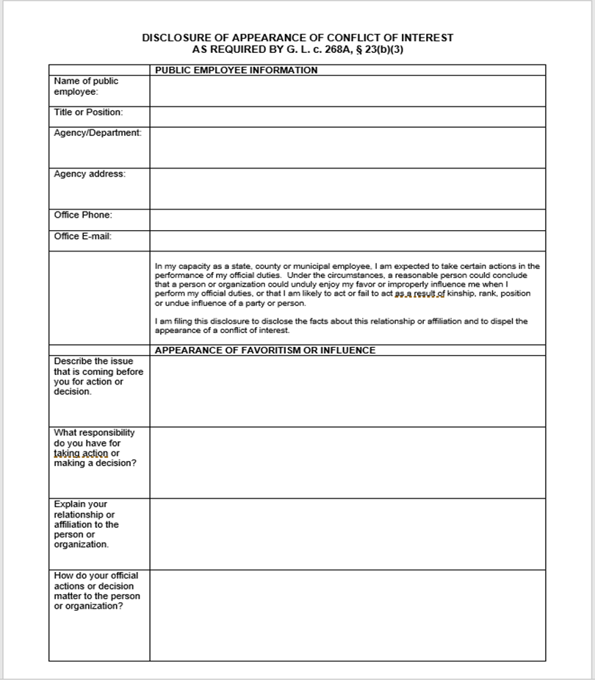
State Ethics Commission
Conflict of Interest Law Disclosures
Must be in writing
Must contain all relevant facts
Must be submitted in advance
Town employees file with their Appointing Authority
Elected town officials file with the Town Clerk’s office
Disclosures are public records

Slide 8
State Ethics Commission
Municipal Employees must complete conflict of interest law education requirements
Anyone performing services for or holding a municipal office, position or employment in a municipal agency
Whether by election, appointment, contract or engagement
Whether serving with or without compensation
On a full-time, part-time, intermittent, or consultant basis
Excludes town meeting members and charter commission members

Slide 9
State Ethics Commission
Are vendor employees required to complete the education requirements?
5-factor test used by the Ethics Commission to determine whether employees of a vendor company are public employees
Are the employee’s services required
Type and size of the vendor company
Degree of specialized knowledge or expertise required
The extent the employee performs or directs services
The extent the employee has provided similar past services
Advisory 06-01: Consultants Who Provide Services to Gov’t Agencies May be Public Employees Subject to the Conflict Law

Slide 10
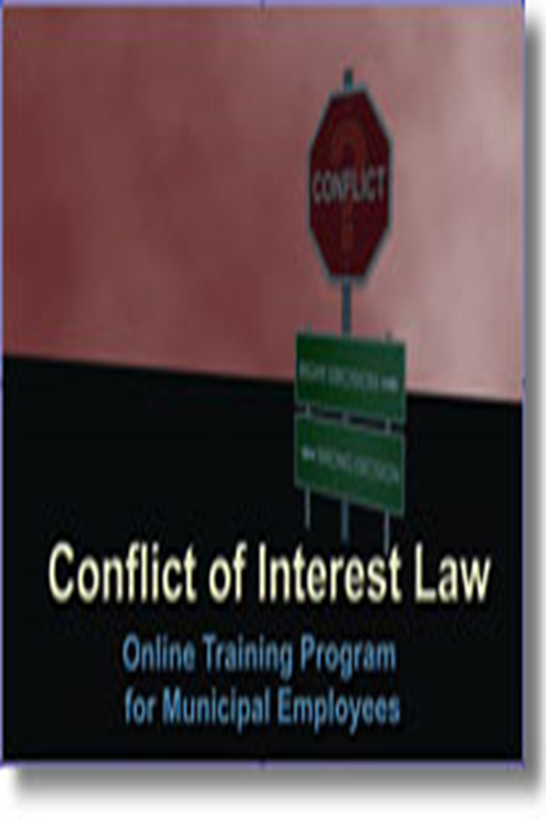
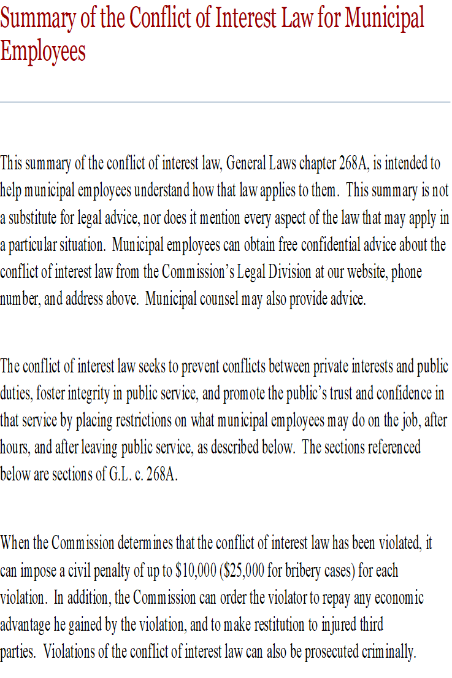
State Ethics Commission
Conflict of Interest Law Educational Requirements
Online Training Program
Summary of the Conflict of Interest Law

Slide 11
State Ethics Commission
Gift Restriction Rules
Bribery: prohibits corrupt gifts, offers, and promises given to influence official acts (Quid Pro Quo).
Gifts/Gratuities: prohibits gifts valued at $50 or more and given because of official acts performed or to be performed.
Gifts: prohibits gifts valued at $50 or more and given because of official position.

Slide 12
State Ethics Commission
Gift Restriction Rules
Section 23(b)(3)- Standards of Conduct: gifts valued at less than $50 are not prohibited, but if the receipt of a gift creates the appearance that the town employee could be improperly influenced in the performance of official duties, a written disclosure is required.

Slide 13
State Ethics Commission
Gifts That May Be Prohibited
Meals
Event Tickets (Advisory 04-1)
Free Travel or Expense Reimbursements
Gift Certificates
Floral Arrangements/Fruit Baskets
Lottery Tickets
Gifts offered through sales promotions

Slide 14
State Ethics Commission
Regulatory Exemptions related to Gift Restrictions
(Disclosure and Prior Approval Required in Certain Circumstances)
Travel Expenses where the purpose of the travel serves a legitimate public purpose
Incidental Hospitality that serves a public purpose
Random Drawings
Unsolicited Perishable Items

Slide 15
State Ethics Commission
Regulatory Exemptions related to Gift Restrictions
(Disclosure and Prior Approval Required in Certain Circumstances)
Passes to School Events Provided by the School District
Class Gifts to Teachers
Public Employee Discounts and Waived Membership Fees
Gifts Among Public Employees
Retirement Gifts

Slide 16
State Ethics Commission
Nepotism/Self-Dealing
A town employee may not participate in matters in which he, his immediate family, a partner, a business organization with which he has certain affiliations or someone with whom he is negotiating for prospective employment has a financial interest.
Disclosure filed with the appointing authority/Determination by the appointing authority
No exemption available for elected town officials
Financial interests of town employees who are abutters or competitors

Slide 17
State Ethics Commission
Nepotism: Definition of Immediate Family Members
Both Sets of Parents
You
Your Spouse
Siblings
Siblings
Your Children

Slide 18
State Ethics Commission
Regulation to allow Town Clerks to Perform Certain Election‑related Functions
The purpose is to permit clerks to perform election‑related functions that clerks are statutorily required to perform, and functions that are not likely to be outcome‑determinative.
During elections in which the town clerk, and/or an immediate family member is a candidate for any office or offices, and
In towns in which the clerk is appointed, during elections in years in which the town clerk's term expires, and the person or persons who appoint the clerk are candidates for any office or offices.
The basis for this exemption is the unique role played by town clerks relating to elections, and the existing extensive regulation of their functions in state election law

Slide 19
State Ethics Commission
Regulation to allow Town Clerks to Perform Certain Election‑related Functions
Examples of what is permitted
A clerk who is a candidate for an office or offices may: make determinations with respect to provisional voters; assist a voter who will be absent on the day of the election in completing a ballot; receive and enter election results; process absent voting ballots; and receive objections to certificates of nomination, nomination papers. An appointed clerk whose appointing authority is a candidate for an office or offices may act as stated in this example.
A clerk, acting as a member of a board of registrars may: perform the duties with respect to absent voting ballot applications; perform the duties with respect to voter registration; and perform the duties with respect to nomination papers. An appointed clerk whose appointing authority is a candidate for an office or offices may act as stated in this example.

Slide 20
State Ethics Commission
Regulation to allow Town Clerks to Perform Certain Election‑related Functions
Example of What is Not Permitted
A clerk who is a member of the board of registrars of voters, and who is a candidate for an office or offices, or whose appointing authority is a candidate for office and it is during the year in which the clerk's term expires, may not, acting by herself and without the participation of other members of the board of registrars of voters, check her own or her adversary's nomination papers or those of her appointing authority and their adversaries, or certify the number of names on her own nomination papers or her adversary's or those of her appointing authority or their adversaries, because state law requires participation by the full board.

Slide 21
State Ethics Commission
Regulation to allow Town Clerks to Perform Certain Election‑related Functions
A clerk who is a candidate for an office or offices may perform election‑related functions that are not required by statute, but that are typically assigned to or performed by the clerk, if such functions are not likely to be determinative of the outcome of the election.
Example: A clerk may perform duties with respect to marking shelves and guard rails in a polling place, which are delegated to her by the Select Board, since such tasks are not likely to be determinative of the outcome of the election.

Slide 22
State Ethics Commission
Code of Conduct
A town employee shall not knowingly:
Act in a manner such that a reasonable person would conclude that he or she might act with bias
One-step written disclosure to dispel appearance of conflict
Use official position to secure unwarranted privileges for him or others.
Use town resources for private or personal use or political activity.
Disclose confidential information.

Slide 23
State Ethics Commission
Code of Conduct: Political Activity
Soliciting campaign support from colleagues, subordinates or constituents
Campaign activities in public buildings
Cannot use town resources for political purposes
Advisory 11-1: Public employee political activity

Slide 24
State Ethics Commission
Divided Loyalties
While a town employee, unless you are a special municipal employee:
You may not represent 3rd party interests before any town board, even if you are not paid.
You may not be paid by anyone to work on any matters in which any agency of the town is a party or has a direct and substantial interest.

Slide 25
State Ethics Commission
Divided Loyalties: Special Municipal Employees
Positions that have been expressly classified by the Board of Selectmen
Are unpaid, or
Compensated for less than 800 hours in a year, or
By terms, classification or conditions of employment, permits personal or private employment during normal working hours
(Generally can include members of boards and committees)

Slide 26
State Ethics Commission
Divided Loyalties Exemptions:
Disciplinary/Personnel issues if uncompensated
Family members if appointing authority approves
Testimony/sworn statements
State and county employees can also be town employees
Can obtain building, electrical, plumbing, gas and septic permits unless employed by the issuing department

Slide 27
State Ethics Commission
Financial Interests in Contracts
A town employee may not have a financial interest in a contract in which the town is an interested party.
Contracts to provide goods or services
Multiple positions, one of which is paid
“Inside Track” issues

Slide 28
State Ethics Commission
Financial Interests in Contracts
A town employee may not have a financial interest in a contract in which the town is an interested party.
Law applies less restrictively to designated “special” municipal employees
Restriction does not apply to elected or unpaid positions
Town employees can also serve on the Board of Selectmen
Other exemptions are available

Slide 29
State Ethics Commission
Financial Interests in Contracts
If not a "special," a town employee may violate the conflict of interest law if they held another position with the town.
Special municipal employees are eligible for an exemption as long as:
• they file a disclosure with the town clerk making full disclosure of the other employment relationship, and, in certain instances,
• the board of selectmen may need to vote to approve an exemption to allow the special to hold the additional position.

Slide 30
State Ethics Commission
Financial Interests in Contracts
Town employees who are not “special” municipal employees can take on additional paid or contracts as long as:
They are not employed by the contracting town agency
They do not participate in any of the activities of the contracting town agency
The contract is made after public notice or through competitive bidding,
The town employee files a disclosure with the town clerk,

Slide 31
State Ethics Commission
Regulatory Exemptions related to Prohibited Financial Interests in Contracts
Exemption of Fee‑based Contractual Relationships Readily Available to the Public (e.g. summer camps, municipal golf course memberships, town-issued permits)
Exemption Related to Senior Tax Abatement Programs *
Exemption of Affordable Housing Programs and Community Development Programs *
Exemption to Permit Town Employees to Participate in Mitigation, Disaster Relief, and Renewable Energy Programs *
* The town employee can have no role in the program administration

Slide 32
State Ethics Commission
Restrictions on Appointment
Board members are ineligible for appointment to positions supervised by their board until 30 days after they resign from the board.
Town employees who also serve on the board of selectmen are ineligible for any other appointment to a town position while a selectman and for 6 months thereafter.
Housing Authority employees who also serve as elected town officials are ineligible for appointment to any other town position until 6 months after they leave the elected position.

Slide 33
State Ethics Commission
Former Municipal Employees: Revolving Door Restrictions
The forever ban
A former town employee is prohibited from receiving compensation from or representing a third party in any particular matter in which he participated as a town employee.
The one year cooling off period
A former town employee is prohibited for one year from appearing personally on behalf of a third party if, within two years prior to his last day of town employment, the matter was under his official responsibility.

Slide 34
State Ethics Commission
Finally:
When in doubt . . .
If a bell goes off or a flag goes up. . . CALL
(617) 371-9500
(800) 485-4766
Visit: www.mass.gov/orgs/state-ethics-commission

